Slide 1
Can we do a “better” code?
nlvduc@gmail.com

Slide 2
How to evaluate performance of a block of code? How long does your program take to solve a problem ?
Time Complexity: O(g(n))
nlvduc@gmail.com
Notes:
Computer science has define this time complexity, to show relation ship of input’s size and running time Easiest way to get this is: your code complexity upper limit is g(x)
Your code can not run faster than g(x) Beside that we have Theta, and Omega

Slide 3
Example: def say_hello(): print("Hello!") # O(1) def counter(): n = 1000 # O(1) while(i < n): # O(n) say_hello() # O(1) i += 1 # O(1) => O(g(N)) with g(N) = 1 + 1 + N* (1 + 1) => O(g(N)) = O(2 + 2*N ) = O(2*N) = O(N)
nlvduc@gmail.com
Notes:
“Basic” operations will be counted as constant time: “+” “-” “*” “/” or compairations but some time (* and /) take more
Rules in:
+ if the scope loop K times then bigO of scope will *K time
+ only get the biggest / eliminate the smallest O(N*2 + N + 23) => O(N*2)
+ eliminate factors doesn’t releated with the input data size

Slide 4
Exercise: Compare two lists, find the differ input: A = [ 1, 3, 2, 6, 4 ,5] B = [ 3 , 7] Algorithim? Iterate through list A check if that element exist in B => O(M*N)
nlvduc@gmail.com
Notes:
Let answer that in next chapter

Slide 5
Searching Algorithms
nlvduc@gmail.com

Slide 6
Linear search def linear_search(A: List[int], key: int)-> None: n = len(A) for i in range(n): if A[i]==key: print(f"Key: {key} exists at {i}.\n") return print(f"Key: {key} doesn't appear in A.\n")
nlvduc@gmail.com

Slide 7
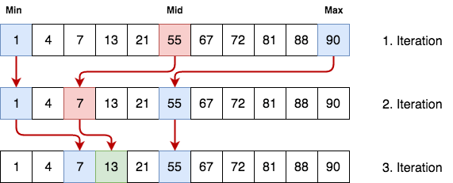
Binary search
nlvduc@gmail.com

Slide 8
Binary search def binary_search(A: List[int], key: int)-> int: n = float(len(A)) left = 0 right = n count = 0 while(left < right): pivot = int((left + right) /2) count += 1 if A[pivot] == key: print(f"Key: {key} exists at {pivot} after {count} loop.\n") return elif A[pivot] < key: left = pivot + 1 elif A[pivot] > key: right = pivot - 1 print(f"Key: {key} doesn't appear in A\n")

Slide 9
Binary search def binary_search(A: List[int], key: int)-> int: n = float(len(A)) # O(1) left = 0 # O(1) right = n # O(1) while(left < right): # O(logn) pivot = int((left + right) /2) # O(1) if A[pivot] == key: # O(1) print(f"Key: found {key} at {pivot} after {count} loop.\n“)#O(1) return elif A[pivot] < key: # O(1) left = pivot + 1 # O(1) elif A[pivot] > key: # O(1) right = pivot – 1 #O(1) print(f"Key: {key} doesn't appear in A\n") #O(1) => binary_search has O(logn) timecomplexity
nlvduc@gmail.com
Notes:
Fact: O(logN) is the lower bound of search algorithms, was proved by use dicision tree

Slide 10
Demo
nlvduc@gmail.com
Notes:
Can we solve the exercise 1 now? Not yet, since the binary search only works on sorted array

Slide 11
Sorting Algorithms
nlvduc@gmail.com

Slide 12
A Sorting Algorithm is used to rearrange a given array. Common Algorithm: + Insertion sort + Bubble sort + quick sort + merge sort
nlvduc@gmail.com
Notes:
Explain about:
bubble sort, insertion sort FACT : quick sort: O(nlogn) implemented in C++#include <algorithm> // std::sort
N log n is the lower bound

Slide 13
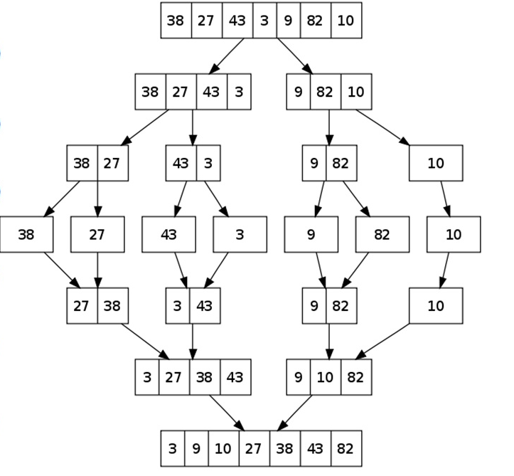
Merge sort
nlvduc@gmail.com

Slide 14
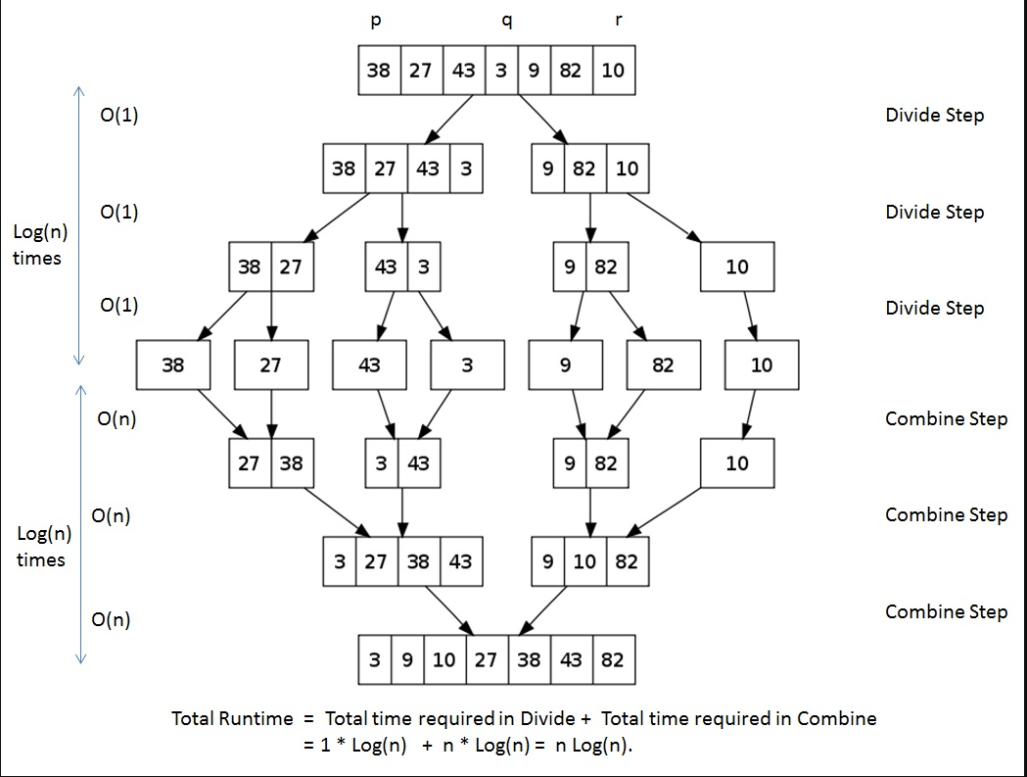
Merge sort
nlvduc@gmail.com
Notes:
Who can explain me why the 4th step takes O(n) complexity?
Now we get back to the exercise one

Slide 15
Exercise: Compare two lists, find the differ input: A = [ 1, 3, 2, 6, 4 ,5] B = [ 3 , 7] Algorithim? Sort one of theme => O(Nlog(N)) iterate through the other: => O(M) search it in sorted list => O(log(N)) => Time complexity: O(Nlog(N) + Mlog(N)) = O(Mlog(N)) ( let say M > N)
nlvduc@gmail.com
Notes:
Let answer that in next chapter

Slide 16
How good our new solution is? suppose M = 50000, N = 10000 O(M*N) = 5 * 10^8 O(M*log(N)) = 2 * 10^5 faster than 2500 times => big deal right ?
nlvduc@gmail.com

Slide 17
Can we do a “better” code?
nlvduc@gmail.com
Notes:
What if I told you we can solve that problem in O(N)??? If you want to known sit down and wait to my next sharing about Data structure and Algorithm

